Slide 2
COMP1206 - Programming 2
Lecture: Serialization
Dr Jian Shi
Jian.Shi@soton.ac.uk
28 February 2020

Slide 3
Topics
Serialization
Deserialization

Slide 4
Object Serialization
We mentioned earlier that in order to store objects to disk we will need to flatten them so that they can be written to a data stream. This is called object serialization.
Let's look at how to do this in Java:
Firstly, in order for an object to be serialized it must be declared 'serializable'. This is done by declaring a class to implement the interface java.io.Serializable. This is what is known as a 'tagging' interface because it has no methods declared in it!
Objects which are of classes which are not declared serializable will not be serialized or deserialized.
Otherwise, objects which are of classes which are declared serializable may have their state recorded and output on a data stream.

Slide 5
ObjectOutputStream and ObjectInputStream
Program
ObjectOutputStream
Serialized Object
ObjectInputStream
Program
Serialization
Deserialization

Slide 6
Serializing an object
To serialize an object we use a java.io.ObjectOutputStream. To use one of these we must construct it using another OutputStream as a parameter. i.e.
where out is an OutputStream
The method:
will actually cause object obj to be serialized to the OutputStream which the ObjectOutputStream wraps.
ObjectOutputStream oos = new ObjectOutputStream ( out )
void writeObject(Object obj)

Slide 7
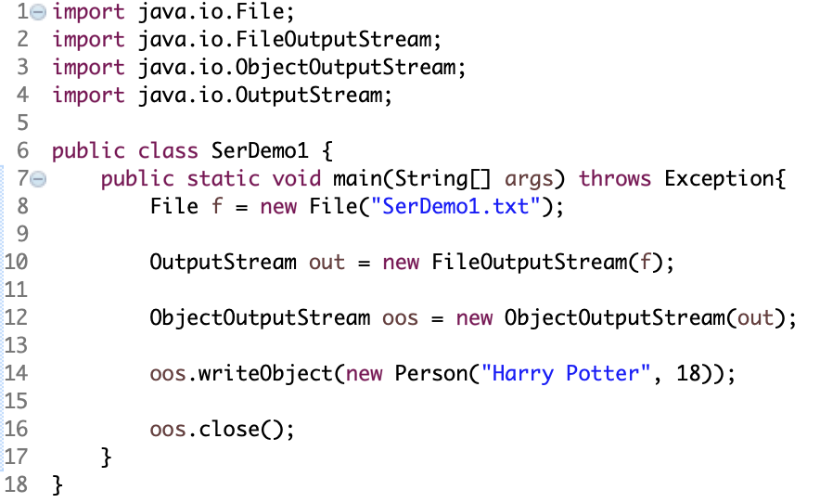
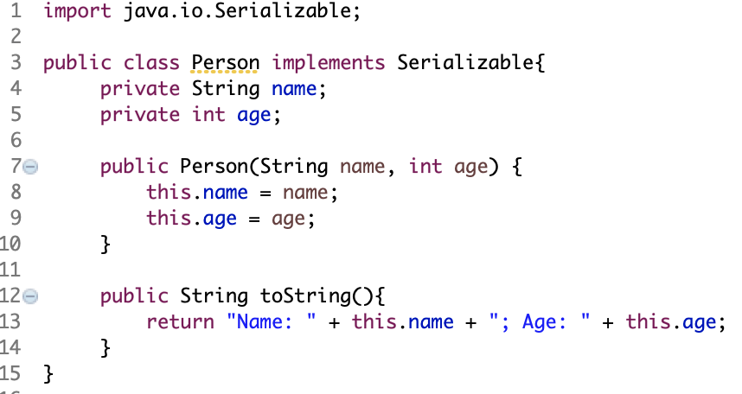
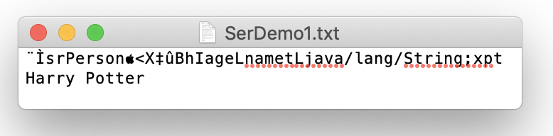
Serialization Example

Slide 8
Deserialization
We can of course reverse this process to read objects from a data file. Again, the objects must be declared to be serializable by their classes implementing the Serializable interface.
To deserialize we use a ObjectInputStream which must be constructed using an InputStream object (this provides the actual stream data).
The magic method then is Object readObject() in which an attempt to read an object from the InputStream is made. This method throws IOExceptions and ClassNotFoundExceptions. This happens for IO problems, or for reading objects which do not correspond to known types.

Slide 9
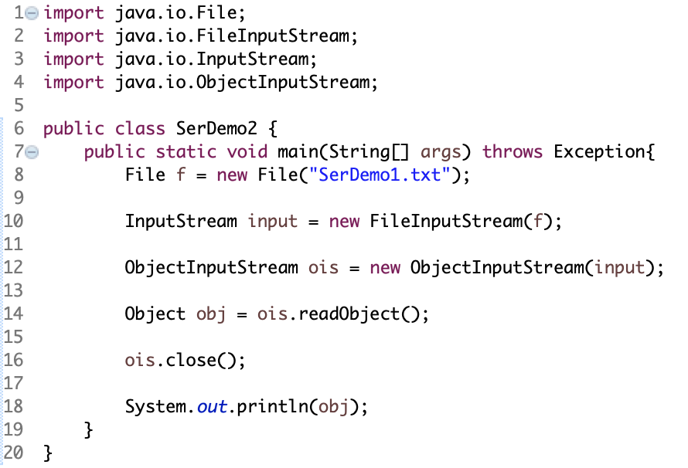
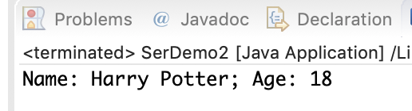
Deserialization Example

Slide 10
FAQ
Q1. What has been preserved/saved during serialization?
A1. ONLY properties. According to OOP, all the objects will share the same methods from the classes, but they may have different values for properties. That is to say, objects keep information of properties only, so only properties will be serialized after serialization.
Q2. Why can’t we make all our classes implement interface Serializable?
A2. No. There might be problems for new version of JDK in the future.
Q3. Why there is a warning for classes implementing Serializable?
A3. Object versioning.

Slide 11
Object Versioning
One big problem with persistent objects is that the actual implementations of classes can vary over time. An object serialized a few months ago may have been serialized from a different implementation of the class that it would be deserialized back to. This can have disastrous consequences.
Therefore, as an object is serialized, a 64-bit secure hash of the full class description is written as part of the object's state. This is called the serial version UID.
At the point of deserialization this serial version UID is read and compared to existing classes. If any implementation details of the class have changed then the UIDs will not match and serialization will fail with an InvalidClassException.
Some changes in implementation may be minor though. If the structure of the class and the representation of object state doesn't really change (for example after a minor bug fix), then an object of the old implementation could still be safely deserialized.

Slide 12
Object Versioning
To facilitate this, you can actually declare the serial version UID of your class explicitly. For example:
Instructs the JVM to use this value as the serial version UID rather than the class' actual hash.
So if I have a class ClassA and I serialize objects of this class and I subsequently change the implementation of ClassA slightly but still wish to be able to deserialize my objects of ClassA then I would set the field above to be the code for the original UID of ClassA.
You can obtain the value of the serial UID for a class using a JDK command line tool called serialVer or by using Eclipse (mouse roll over the Serializable declaration and choose "Add default serial version ID"). In principle you can also use any consistent numbering scheme you like for this - it is better practice to stick to the generated ones though.
private static final long serialVersionUID = -1328632082376423400L;

Slide 13
Serialization of reference types
In the previous examples, the class Person had two fields. It is fairly clear how the JVM might go about serializing this class: write some information about the class name (actually a hashcode), and then the values of the two variable fields.
But suppose that this class also had a field called friend of type Person. Then in order to serialize an object of class Person then the JVM would need to serialize its friend Person object also. This is fine, recursion would help with that.
But suppose that this class also had a field called address of another class type Address. In order to serialize a Person object, the JVM now has to serialize an Address object as well. Again, this is fine, by recursion, but only if Address is also declared as serializable!

Slide 14
Serialization of reference types
Person
String name = “Harry”
Person friend1 =
Person friend2 =
In essence then, when one calls for serialization of an object, the JVM must serialize the whole object graph that is heap reachable from that object. This raises the question about aliased references:
In order to be faithful to the object state, serialization must preserve the graph structure. Thus, if an object has already been serialized and is referred to via another field, then it should not be serialized again as a distinct object.
Person
String name = “Ron”
Person friend1 =
Person friend2 =
Person
String name = “Luna”
Person friend1 =
Person friend2 =
Person
String name = “Hermione”
Person friend1 =
Person friend2 =

Slide 15
Externalizable Interface
Serializable interface will serialize all the properties of the object.
Externalizable interface will allow developers to specify what to serialize.
There are two methods in Externalizable interface
writeExternal (ObjectOutput out)
readExternal (ObjectInput in)
Constructer
There has to be a constructer with no parameters

Slide 16
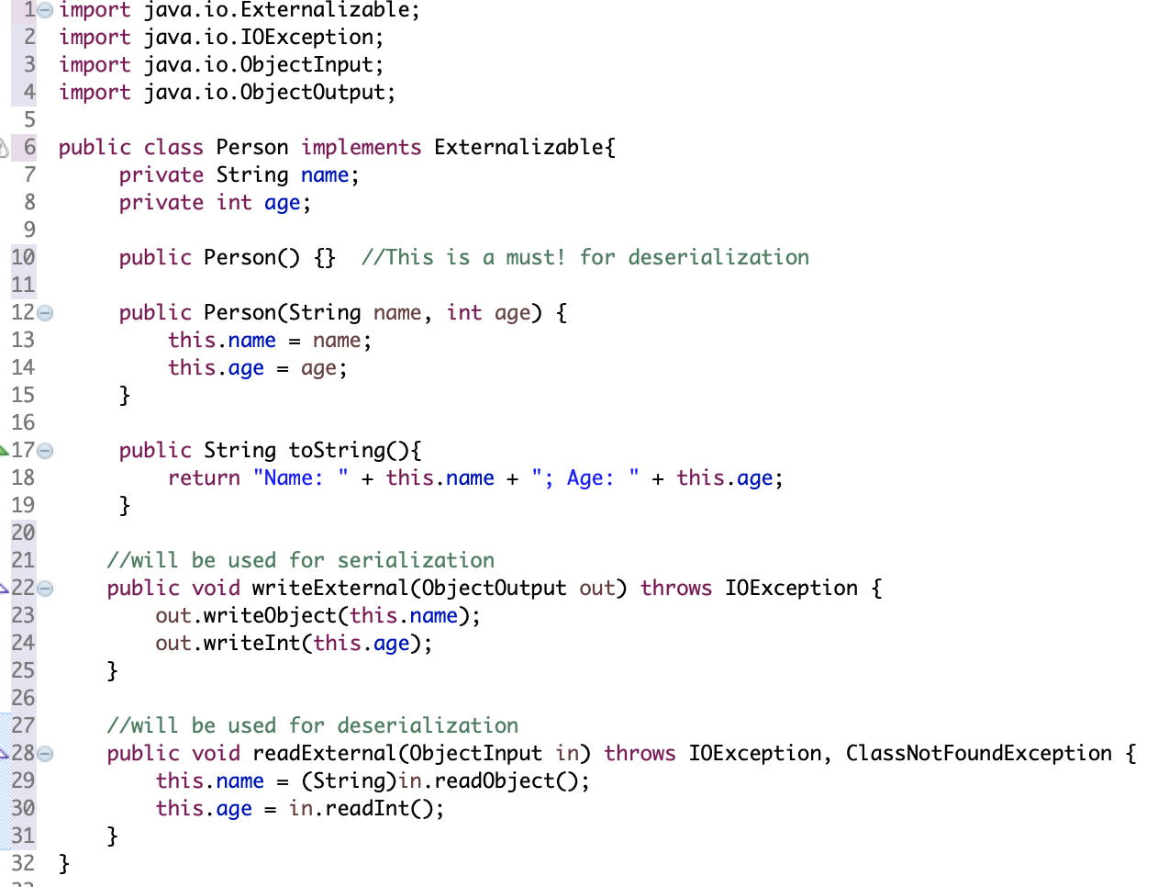
Externalizable Example

Slide 17
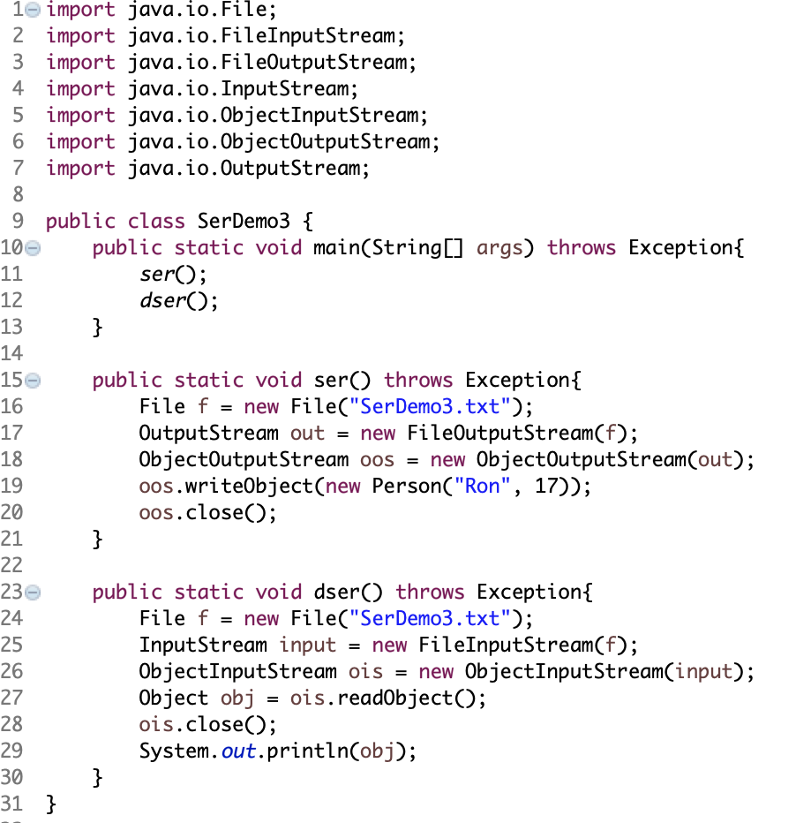

Externalizable Example
Final output:

Slide 18

Keyword transient
We can see that Externalizable is bit complicated.
At the time of serialization, if we don’t want to save value of a particular variable in a file, then we use transient keyword.
For example, in the initial Person example, if we do NOT want property String name to be serialized, then simply add transient as a modifier:
Then when we re-run the main method, the output will be:
private transient String name;

Slide 19
Summary
Serialization of objects is done via the writeObject method of an ObjectOutputStream object.
Deserialization of objects is done via the readObject method of an ObjectInputStream object.
Versions of classes can be recognised during deserialization.
Externalizable Interface
Keyword transient

